Slide 1


FAIR-by-Design Methodology: How to Develop FAIR Materials
Sonja Filiposka, UKIM
orcid.org/0000-0003-0034-2855

Slide 2

Why FAIR Learning Materials?
Do
Practice what you preach
Show
Lead by example
Join
Build a community for co-creation
Persist
Be a reflection of what you’d like to see in others

Slide 3
FAIR for ALL
FAIR for Learners
Instructors
+
Find training content that can be easily accessed using common applications. Come back and revisit whenever needed.
Find existing training materials, access their editable versions, fully understand the context and reuse according to the licensing terms.

Slide 4
FAIR requires commitment
New skills
The development process requires knowledge about metadata, PIDs, repos, licensing, attribution, open file formats in addition to the typical learning materials design stuff
Time, Time, More Time
Additional work requires additional time. To provide full context and improve reusability, time is needed to make a record of all related information.
Fast
Easy
Devil is in the details
To be able to really reuse the materials they need to be accompanied with an instructor kit
Quick Fix
From the start
FAIR as an afterthought may require substantial redo, aim to think FAIR-by-Design
Just share

Slide 5
FAIR-by-Design Methodology
Backward Instructional Design Empowered with FAIR principles
focusing on both learners and peer instructors
Prepare
Discover
Design
Produce
Publish
Verify
Deliver
1. Do you understand FAIR and its implications?
2. Define purpose, learning objectives, target audience
1. Find existing resources
2. Identify potential for reuse
attribution
tools & formats
1. Define syllabus and structure
- facilitation materials
- granularity
2. Decide on license
1. Develop content
- compatibility
2. Define metadata
3. Internal QA check
1. Release to public
- for learners & instructors
2. Ensure accessibility
- define attribution
3. Enable feedback gathering
1. Final QA check
2. Add to training catalogue
3. Use gathered feedback for continuous improvement

Slide 6
1 - Prepare
Package of:
min 1 learning outcome
lesson plan
lesson content
min 1 activity
assessment
facilitation guide
Define:
Purpose
Target audience
Prerequisites
Scope
Learn FAIR
Start Backward Instructional Design
Formulate Learning Objectives
Define FAIR Learning Objects
Ideate
Know how to curate and share FAIR data
Have legal IPR expertise
RDA min metadata schema
Focus on the learning outcomes that one wants to achieve. Work backward to the topics that need to be covered to achieve the learning objectives
Describe what new knowledge and skills will be obtained in a specific, measurable, attainable, relevant and time-bound (SMART) way
Use the Bloom’s Taxonomy

Slide 7
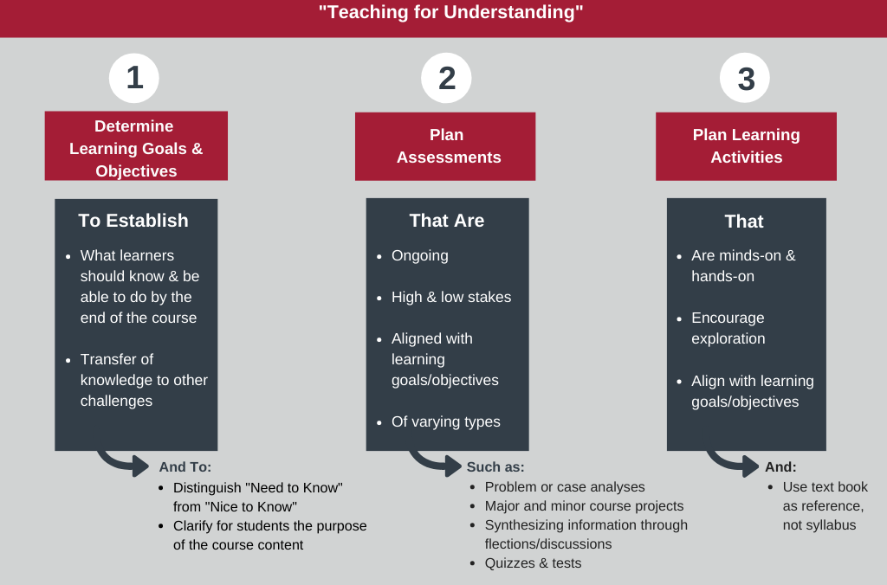
Backward Instructional Design
"Backward design model" from Muhlenberg College licensed under the CC BY-NC 4.0.

Slide 8
2 - Discover
Get Inspired!
OER
EOSC
General
Multimedia
EOSC Training catalogue on the EOSC Marketplace
Most EOSC projects have their own training catalogues and/or platforms
Creative Commons Search - content provided under a CC license
Zenodo - a multi-disciplinary open repository
OSF - a free, open platform
There is no one key to rule them all
Discovery is a lengthy, windy process
Closed learning resources have value too
DOAB
MERLOT
OASIS
OER Commons
OERTX CORA
GALILEO
FORRT
Provide for all learning modalities:
Read/write
Auditory
Visual
Kinesthetic

Slide 9
3 - Design
Create granular learning resources that can be easily reused
Mix and match while respecting licensing rules
A document that represents the trainers view and aims to enable a smooth and efficient training
Concept
Develop
Feedback form
Facilitation Guide
Structure
Learning unit plan
Hunter’s Model
Content
Notebook
Slides
Activities
Assessment
Quiz questions
Strategy
Sketch a content concept map
Prepare a syllabus
Learners should be able to provide feedback on what worked well and what should be improved in the training and learning materials

Slide 10

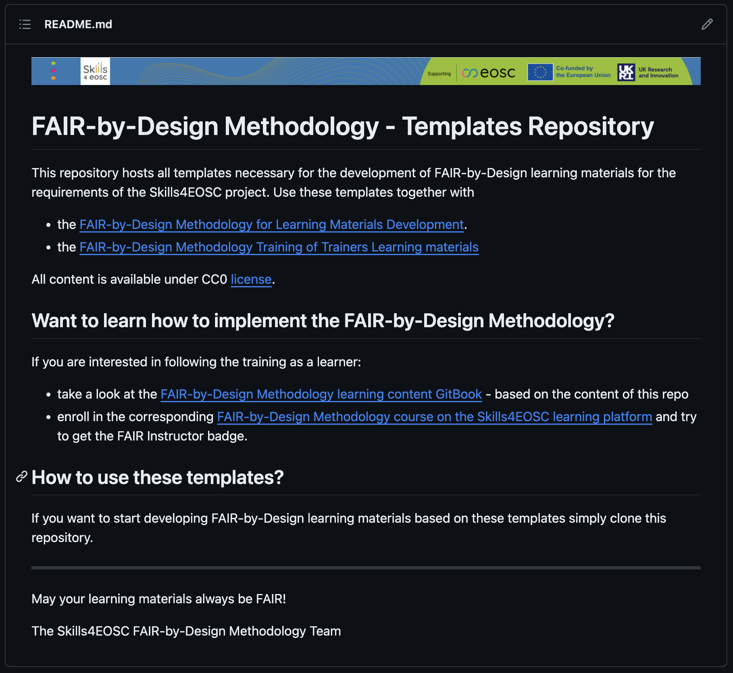
Templates Repository
https://github.com/FAIR-by-Design-Methodology/templates

Slide 11

4 - Produce
Tools & Formats
Accessibility
Re-iterate & Finalise
Internal QA
Editable vs Final
Open file formats
Web & Multimedia friendly
Granular versioning
Collaborative environment
Cover the widest range of learner variability
w+w/o assistive technology
W3C WCAG 2.1(2.2)
PDF/UA
Use accessibility evaluation tools!
Back and forth iterations
Metadata = human + machine – readable
License
Facilitation Guide
Self-assessment
Quantitative: required elements
Qualitative: per LU

Slide 12
File Formats & Tools Recommendations
Editable content -> MD + PPTX
Final content -> HTML GitBook-like + PDF
Granular versioning and collaborative environment -> GitHub

Slide 13
5 - Publish
Final preparations
To Repository
To LMS
Accompanying Files
(Auto) Workflow
For Learners
Readme
Citation
Code of conduct
…
Zenodo + GitHub Link
New Version Release
Approve
Add final content
Add question bank
Create quizzes
Setup feedback gathering
Add webinar room
Define badges/certificates

Slide 14
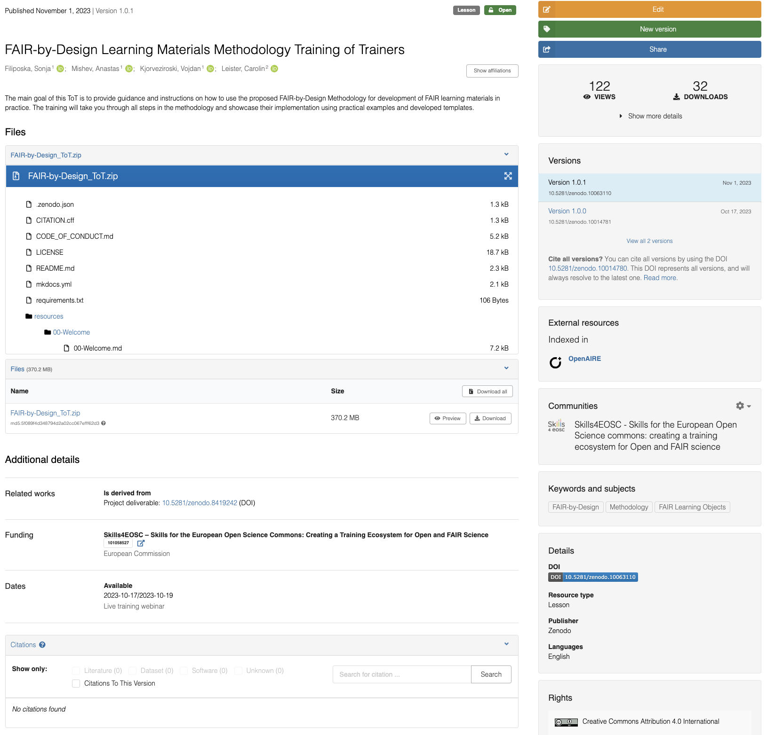
https://zenodo.org/records/10063110

Slide 15
6 - Verify
FAIR-by-Design QA checklist
Required vs optional
Review w/o cognitive bias
From a new learner perspective
Setup gathering from both perspectives
QA checklist
Level of FAIRness
External QA
LMS QA
Feedback QA

Slide 16
FAIR-by-Design Methodology (recap)
Backward Instructional Design Empowered with FAIR principles
focusing on both learners and peer instructors
Prepare
Discover
Design
Produce
Publish
Verify
Deliver

Slide 17





Continuous Improvement
GitHub issues
Fork and pull requests
Direct mail contact
Other means of communication
Select items from the list that will be part of a new version
2017
Internal
External
Analyse
Improve
Repeat
Feedback form
QA recommendations
Self-reflection after training
Create a list of potential improvements with impact level (high, moderate, low)
Start a new cycle of the FAIR-by-Design methodology

Slide 18
FAIR-by-Design Methodology Details
Up-to-Date Methodology
https://fair-by-design-methodology.github.io/FAIR-by-Design_Book/
ToT course on Skills4EOSC LMS
https://learning.skills4eosc.eu/course/view.php?id=19
Training GitBook
https://fair-by-design-methodology.github.io/FAIR-by-Design_ToT/latest/
GitHub
https://github.com/FAIR-by-Design-Methodology/FAIR-by-Design_ToT

Slide 19


Thank you! Questions? Credit: Some of the slides in this presentation were created by SlideEgg

